Slide 1
CLASS PROBABILITIES

Slide 2
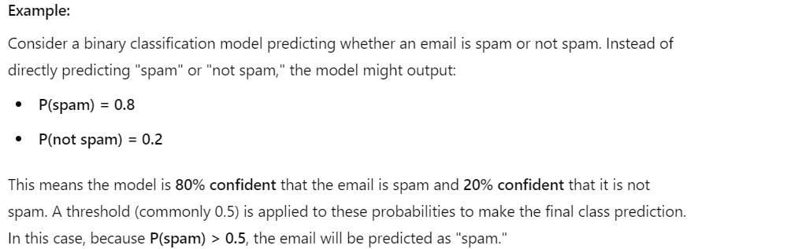
Class probabilities represent the likelihood that an instance belongs to each class.
Instead of directly giving a class label, the model outputs a probability score between 0 and 1 for each class.
These probabilities indicate the model's confidence in its predictions.

Slide 3
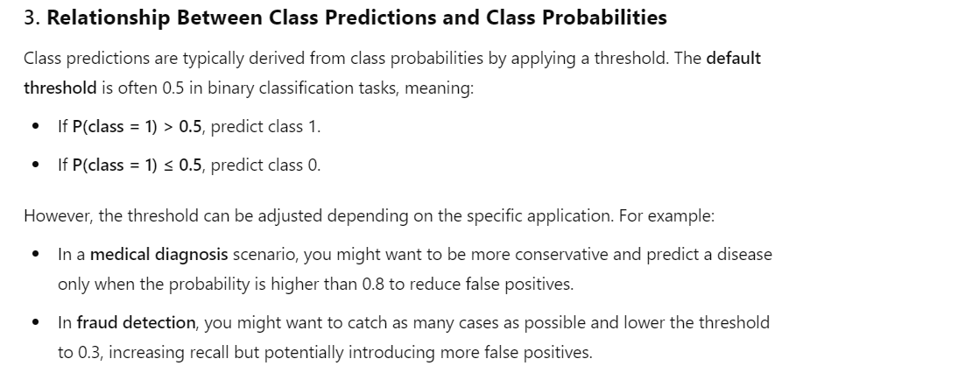

Slide 4
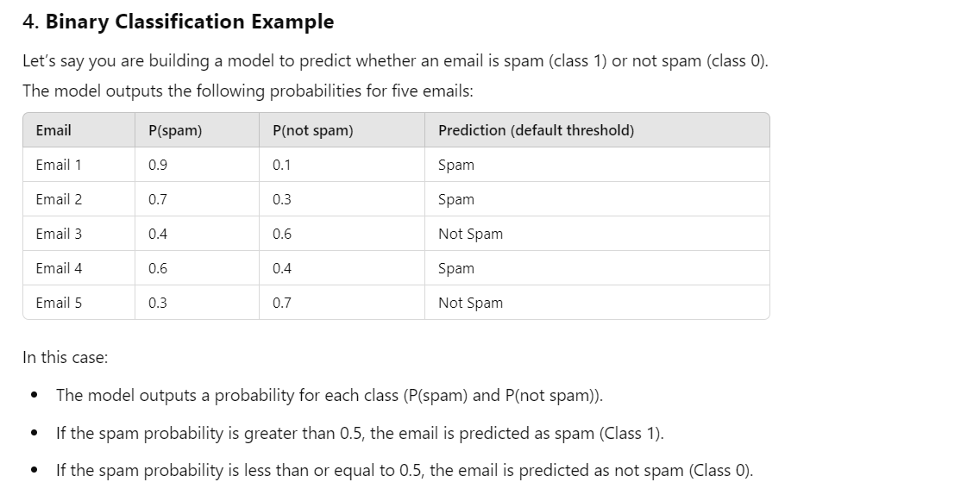

Slide 5
